Slide 1
CS 371
Artificial Intelligence
Samyan Qayyum Wahla
Fall 2023
Course Credits: Stanford-CS221

Slide 2


Slide 3
Course Roadmap

Slide 4

How to Approach towards Solution of AI tasks?

Slide 5
Paradigm
Major Pillars
Modeling
Learning
Inference

Slide 6
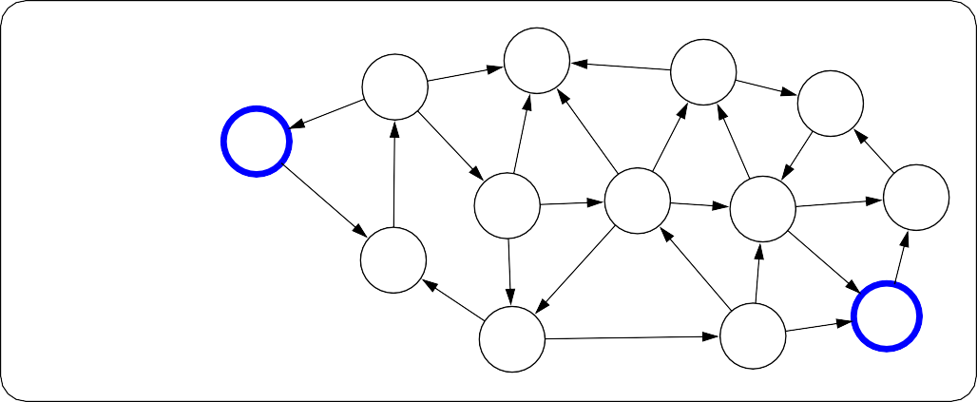
Paradigm
Modeling
Real world
6
7
4
5
5
5
3
1
Model
0
8
6
3
8
8
1
1
7
2
3
6
7
2
4
8
6
Notes:
The first pillar is modeling. Modeling takes messy real world problems and packages them into neat formal mathematical objects called models, which can be subject to rigorous analysis and can be operated on by computers. However, modeling is lossy: not all of the richness of the real world can be captured, and therefore there is an art of modeling: what does one keep versus ignore? (An exception to this are games such as Chess, Go or Sodoku, where the real world is identical to the model.)
As an example, suppose we’re trying to have an AI that can navigate through a busy city. We might formulate this as a graph where nodes represent points in the city, edges represent the roads, and the cost of an edge represents the traffic on that road.

Slide 7

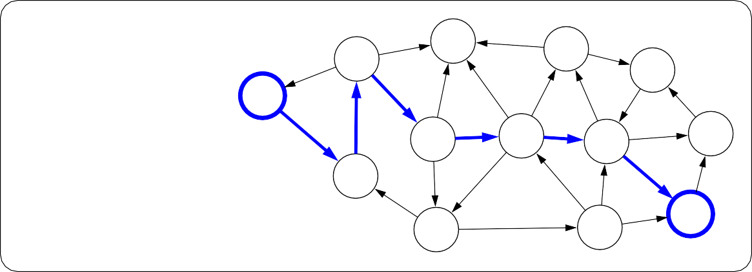
Paradigm
Inference
6
7
4
5
5
5
3
1
Model
0
8
6
3
8
8
1
1
7
2
3
6
7
2
4
8
6
Inference
6
7
4
5
8
5
5
3
1
Predictions
0
6
3
8
8
1
1
7
2
3
6
7
2
4
8
6
Notes:
The second pillar is inference. Given a model, the task of inference is to answer questions with respect to the model. For example, given the model of the city, one could ask questions such as: what is the shortest path? what is the cheapest path?
The focus of inference is usually on efficient algorithms that can answer these questions. For some models, computational complexity can be a concern (games such as Go), and usually approximations are needed.

Slide 8
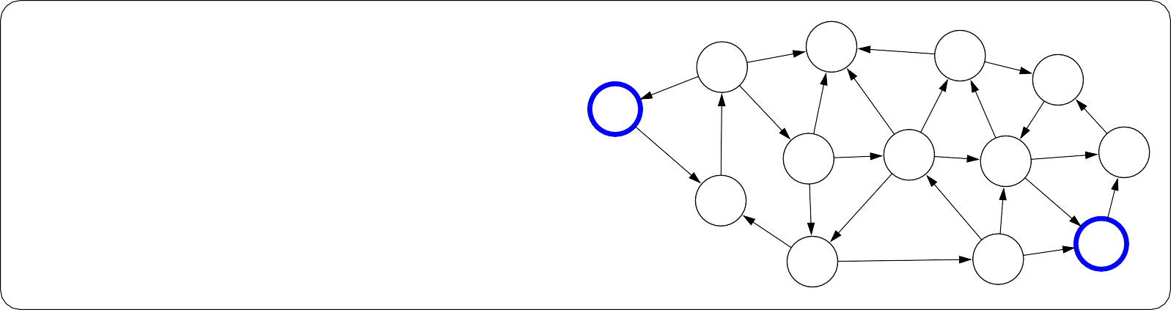
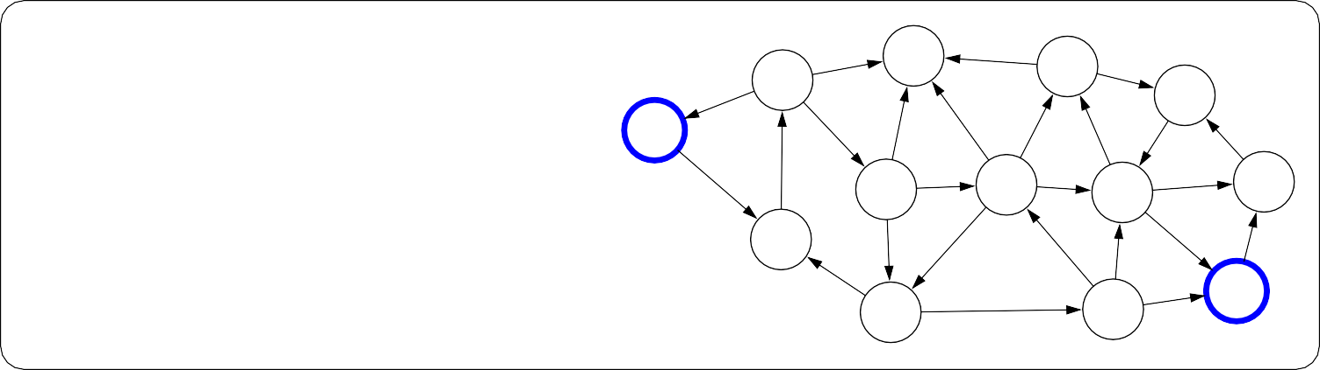
Paradigm
Learning
?
?
?
?
?
?
?
?
Model without parameters
?
?
?
?
+ Data
?
?
?
?
?
?
?
?
?
?
?
?
?
Learning
6
7
4
5
5
5
3
1
Model with parameters
0
8
6
3
8
8
1
1
7
2
3
6
7
2
4
8
6
Notes:
But where does the model come from? Remember that the real world is rich, so if the model is to be faithful, the model has to be rich as well. But we can’t possibly write down such a rich model manually.
The idea behind (machine) learning is to instead get it from data. Instead of constructing a model, one constructs a skeleton of a model (more precisely, a model family), which is a model without parameters. And then if we have the right type of data, we can run a machine learning algorithm to tune the parameters of the model.
Note that learning here is not tied to a particular approach (e.g., neural networks), but more of a philosophy.
This general paradigm will allow us to bridge the gap between logic-based AI and statistical AI.

Slide 9
Course Plan
Low Level Intelligence
High Level Intelligence
Artificial Intelligence
Notes:
We now embark on our tour of the topics in this course. The topics correspond to types of models that we can use to represent real-world tasks. The topics will in a sense advance from low-level intelligence to high-level intelligence, evolving from models that simply make a reflex decision to models that are based on logical reasoning.

Slide 10
Machine Learning
The main driver of recent successes in AI
Move from ”code” to ”data” to manage the information complexity
Requires a leap of faith: generalization
Data
Model
Notes:
Supporting all of these models is machine learning, which has been arguably the most crucial ingredient powering recent successes in AI. From a systems engineering perspective, machine learning allows us to shift the information complexity of the model from code to data, which is much easier to obtain (either naturally occurring or via crowdsourcing).
The main conceptually magical part of learning is that if done properly, the trained model will be able to produce good predictions beyond the set of training examples. This leap of faith is called generalization, and is, explicitly or implicitly, at the heart of any machine learning algorithm. This can even be formalized using tools from probability and statistical learning theory.

Slide 11
Course Plan
Reflex
Low Level Intelligence
High Level Intelligence
Artificial Intelligence
Notes:
We now embark on our tour of the topics in this course. The topics correspond to types of models that we can use to represent real-world tasks. The topics will in a sense advance from low-level intelligence to high-level intelligence, evolving from models that simply make a reflex decision to models that are based on logical reasoning.

Slide 12

What is this building?

Slide 13
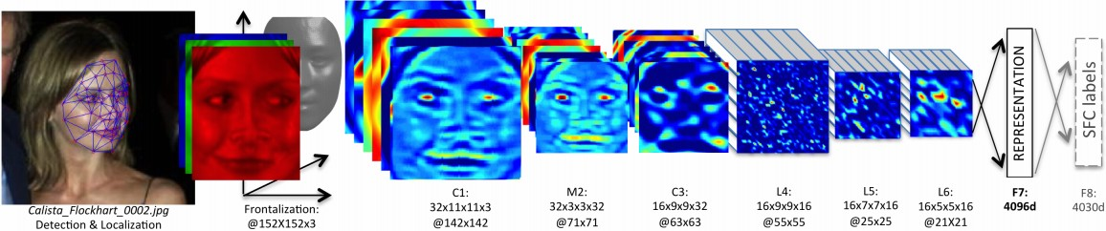
Reflex Based Models
Examples: linear classifiers, deep neural networks
Most common models in machine learning
Fully feed-forward (no backtracking)

Slide 14
Course Plan
Search problems
Markov decision processes
Adversarial games
Reflex
States
Low Level Intelligence
High Level Intelligence
Artificial Intelligence
Notes:
We now embark on our tour of the topics in this course. The topics correspond to types of models that we can use to represent real-world tasks. The topics will in a sense advance from low-level intelligence to high-level intelligence, evolving from models that simply make a reflex decision to models that are based on logical reasoning.

Slide 15
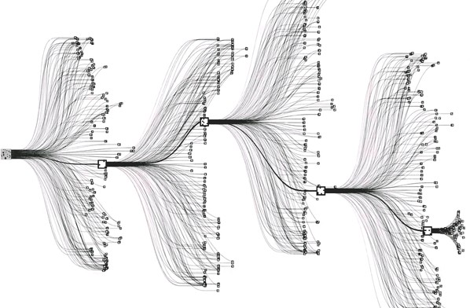
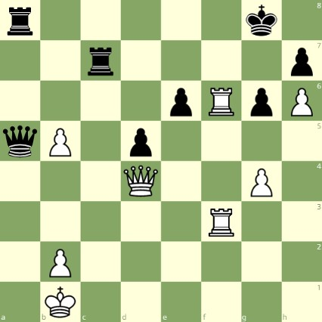
State Based Models
Applications:
Games: Chess, Go, Pac-Man, Starcraft, etc.
Robotics: motion planning
Natural language generation: machine translation, image captioning, Chat GPT
White to move
Notes:
Reflex-based models are too simple for tasks that require more forethought (e.g., in playing chess or planning a big trip). State-based models overcome this limitation.
The key idea is, at a high-level, to model the state of a world and transitions between states which are triggered by actions. Concretely, one can think of states as nodes in a graph and transitions as edges. This reduction is useful because we understand graphs well and have a lot of efficient algorithms for operating on graphs.

Slide 16


State Based Models
Search problems: you control everything
Markov decision processes: against nature (e.g., Blackjack)
Adversarial games: against opponent (e.g., chess)
Notes:
Search problems are adequate models when you are operating in an environment that has no uncertainty. However, in many realistic settings, there are other forces at play.
Markov decision processes handle tasks with an element of chance (e.g., Blackjack), where the distri- bution of randomness is known (reinforcement learning can be employed if it is not).
Adversarial games, as the name suggests, handle tasks where there is an opponent who is working against you (e.g., chess).

Slide 17
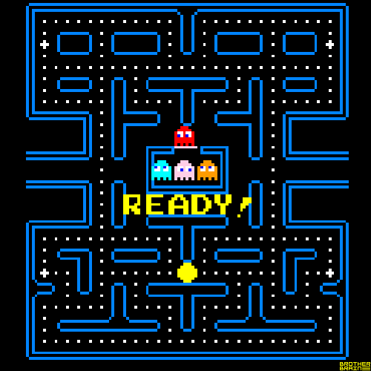
Pac-Man

Slide 18
Course Plan
Search problems
Markov decision processes
Adversarial games
Constraint satisfaction problems
Bayesian networks
Reflex
States
Variables
Low Level Intelligence
High Level Intelligence
Artificial Intelligence
Notes:
We now embark on our tour of the topics in this course. The topics correspond to types of models that we can use to represent real-world tasks. The topics will in a sense advance from low-level intelligence to high-level intelligence, evolving from models that simply make a reflex decision to models that are based on logical reasoning.

Slide 19
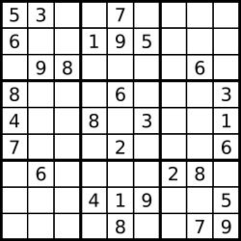
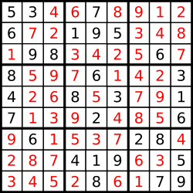
Sudoku
Goal: put digits in blank squares so each row, column, and 3x3 sub-block has digits 1–9
Note: order of filling squares doesn’t matter in the evaluation criteria!
Notes:
In state-based models, solutions are procedural: they specify step by step instructions on how to go from A to B. In many applications, the order in which things are done isn’t important.

Slide 20
Variable-based models
Constraint scheduling)
satisfaction problems: hard constraints
(e.g.,
Sudoku,
X₁
X₂
X₃ X₄
Bayesian networks: soft dependencies (e.g., tracking cars from sensors)
H₁ H₂ H₃ H₄ H₅
E₁
E₂
E₃
E₄
E₅
Notes:
Constraint satisfaction problems are variable-based models where we only have hard constraints. For example, in scheduling, we can’t have two people in the same place at the same time.
Bayesian networks are variable-based models where variables are random variables which are dependent on each other. For example, the true location of an airplane H_{t} and its radar reading E_{t} are related, as are the location H_{t} and the location at the last time step H_{t−1}. The exact dependency structure is given by the graph structure and it formally defines a joint probability distribution over all of the variables. This topic is studied thoroughly in probabilistic graphical models (CS228).

Slide 21
Course Plan
Search problems
Markov decision processes
Adversarial games
Constraint satisfaction problems
Bayesian networks
Reflex
States
Variables
Logic
Low Level Intelligence
High Level Intelligence
Artificial Intelligence

Slide 22
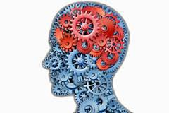


Motivation: Virtual Assistant
Tell information
Ask questions
Use natural language!
[demo]
Need to:
Digest heterogenous information
Reason deeply with that information
Notes:
Our last stop on the tour is logic. Even more so than variable-based models, logic provides a compact language for modeling which gives us more expressivity.
It is interesting that historically, logic was one of the first things that AI researchers started with in the 1950s. While logical approaches were in a way quite sophisticated, they did not work well on complex real-world tasks with noise and uncertainty. On the other hand, methods based on probability and machine learning naturally handle noise and uncertainty, which is why they presently dominate the AI landscape. However, they are yet to be applied successfully to tasks that require really sophisticated reasoning.
In this course, we will appreciate the two as not contradictory, but simply tackling different aspects of
AI — in fact, in our course plan, logic is a class of models which can be supported by machine learning. An active area of research is to combine the richness of logic with the robustness and agility of machine learning.
One motivation for logic is a virtual assistant. At an abstract level, one fundamental thing a good personal assistant should be able to do is to take in information from people and be able to answer questions that require drawing inferences from these facts.
In some sense, telling the system information is like machine learning, but it feels like a very different form of learning than seeing 10M images and their labels or 10M sentences and their translations. The type of information we get here is both more heterogenous, more abstract, and the expectation is that we process it more deeply (we don’t want to tell our personal assistant 100 times that we prefer morning meetings).
And how do we interact with our personal assistants? Let’s use natural language, the very tool that was built for communication!

Slide 23
Course Logistics

Slide 24
WHO ARE WE?
Lecturer: Samyan Qayyum Wahla
  UET Lahore (BS & MS)
  Research Interests: Machine Learning & Computer Vision
  Experience: Software Engineer, Software Architect, Research Lead
Course Assistants (CAs)
  Khadija Asif
  Muhammad Zeeshan

Slide 25
COURSE INFRASTRUCTURE
Course website: eduko.spikotech.com
  Lecture slides, homework handouts, section handouts, quiz handouts, course policies, office hour & homework schedules, & more
Office Hours:
  Office hours will be announced on course website. I will recommend to get the appointment through mail first.
  samyan.uet@gmail.com
  Mention Registration Number, Course Code in Subject

Slide 26
TENTATIVE LECTURE PLAN
TENTATIVE LECTURE PLAN
Week | Content
Week 01 | Course Overview History of AI Perspective towards AI Course Roadmap Course Logistics
Week 02 | Problem Reduction Methods Dynamic Programming Optimizations Discrete Optimization(Edit Distances) Continuous Optimization(Gradient Descent on single variable)
Week 03 | Search Tree Search Depth-First, Breadth-First Hill climbing, Beam Dynamic Programming
Week 04 | Uniform Cost Search A*, Heuristic Search

Slide 27
TENTATIVE LECTURE PLAN
Week 05 | Machine Learning Unsupervised Learning Kmeans Game Theory Minimax alpha-beta and Progressive Deepening Search
Week 06 | Constraint Satisfaction Problems Interpretation Line Drawings, Search and Domain Reduction
Week 07 | Constraint Satisfaction Problems Constraints Visual Object Recognition
Week 08 | Bayesian Networks Hidden Markov Models
Week 09 | Mid Term Week
Week 10 | Logic: First Order Logic

Slide 28
TENTATIVE LECTURE PLAN
Week 11 | Machine Learning Linear Classification Loss Minimization Stochastic Gradient Descent
Week 12 | Machine Learning Features Non-Linearity Neural Networks
Week 13 | Machine Learning Nearest Neighbours ID Trees
Week 14 | Deep Learning Autoencoders CNN
Week 15 | Deep Learning RNN
Week 16 | Final Term

Slide 29
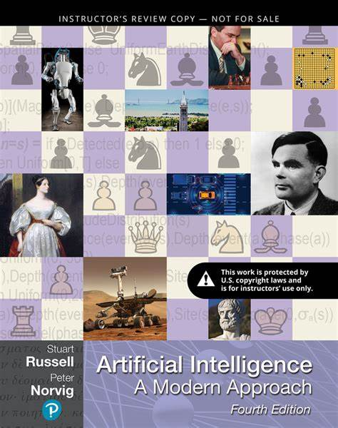
Textbook
Artificial Intelligence: A Modern Approach by Russell

Slide 30
GRADED COURSE COMPONENTS
Text Book Exercises
Selective exercises released on Eduko to check your understanding of lecture material
Problem Set (PSet):
More involved questions that apply lecture concepts (algorithm design questions, proofs)
Exams
Mid Term and Final Term Exam
Projects
Projects to apply concepts on real world
Quizzes
Short quizzes.
Format may vary

Slide 31




COURSE GRADING POLICY
Exam
60%
Projects
15%
Quizzes
15%
Problem Sets & Exercises
10%

Slide 32
PLAGIARISM POLICY
Plagiarism implies copying work produced by someone else. Each student is expected to maintain the highest standards of honesty and integrity in academic and professional matters. The University reserves the right to take disciplinary action, including dismissal, against any student who is found responsible for academic dishonesty. Any student who has been judged to have engaged in academic dishonesty in course work may receive a reduced or failing grade for the work in question and/or for the course. Academic dishonesty includes, but is not limited to, dishonesty in quizzes, tests or assignments; claiming credit for work not done or done by others; hindering the academic work of other students; and misrepresenting academic or professional qualifications within or outside the University.

Slide 33
OTHER COURSE POLICIES
All course policy details are listed in course outline
Some important policies to mention:
  Homework collaboration policy
  Late problem set policy
  Regrade policy

Slide 34
COURSE FEEDBACK
We’re always trying to evolve this class, so please leave us feedback!.
We’ll also have feedback surveys at the end of each homework that ask about more specific aspects of the course.

Slide 35
PERSONAL SUPPORT
If you ever feel overwhelmed with university, your work, your home, your health, your family, world concerns, community concerns, the general state of the world, etc., please don’t hesitate to reach out. We want to support you both as a student working to succeed in this course and as a person trying to make it through everything that life hurls at us. We’re here for you if you need to talk, find resources, figure out what it is you even need, or really anything at all. You can find us on email.

